Slide 1
Session 4.5 JavaScript Libraries, Frameworks and Jquery

Slide 2
Contents
JavaScript Libraries and Frameworks
JavaScript Jquery Intro
Using Jquery on Page and from CDN
Jquery Demos
Notes:
CDN-Content Delivery Network

Slide 3
JavaScript Libraries
Advanced JavaScript programming can be handled easily and in less time.
Common JavaScript tasks like animations, DOM manipulation, and Ajax handling.
Some of the most popular JavaScript frameworks:
jQuery
Prototype
MooTools

Slide 4
CDN-Content Delivery Networks
A CDN is a network of servers containing shared code libraries.
Google provides a free CDN for a number of JavaScript libraries, including:
jQuery
Prototype
MooTools
Dojo
Yahoo!YUI
Notes:
A content delivery network or content distribution network (CDN) is a large distributed system of servers deployed in multiple data centers across the Internet. The goal of a CDN is to serve content to end-users with high availability and high performance. CDNs serve a large fraction of the Internet content today, including web objects (text, graphics and scripts), downloadable objects (media files, software, documents), applications (e-commerce, portals), live streaming media, on-demand streaming media, and social networks.
A CDN operator gets paid by content providers such as media companies and e-commerce vendors for delivering their content to their audience of end-users.

Slide 5
jQuery
jQuery is the most popular JavaScript framework on the Internet today.
It uses CSS selectors to access and manipulate HTMLelements (DOM Objects) on a web page.
Many of the largest companies on the Web use jQuery:
• Google
• Microsoft
• IBM
• Netflix

Slide 6
Benefit of jQuery
jQuery will run exactly the same in all major browsers, also Internet Explorer 6!
It uses CSS selectors to access and manipulate HTML elements (DOM objects)
jQuery is a lightweight, “write less, do more”, JavaScript library.
jQuery has plugins for almost any task out there.

Slide 7
jQuery Features
The jQuery library is a single JavaScript file
<script> in this case should be in <head> not <body>
The jQuery library contains the following features:
HTML/DOM manipulation
CSS manipulation
HTML event methods
Effects and animations
AJAX
Utilities

Slide 8



jQuery CDN Locations
http://ajax.googleapis.com/ajax/libs/jquery/1.11.2/jquery.min.js
http://ajax.aspnetcdn.com/ajax/jQuery/jquery-1.11.2.min.js
http://code.jquery.com/jquery-1.11.1.min.js

Slide 9
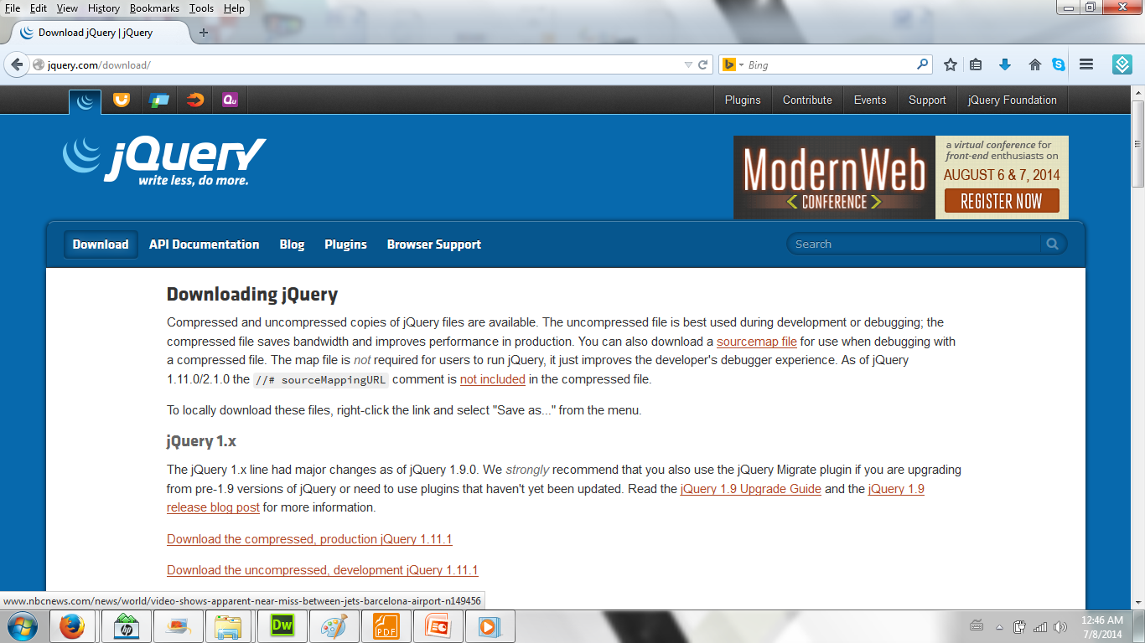
http://www.jquery.com

Slide 10
Load jQuery Framework
Code to load jQuery Framework from Google CDN
<script type="text/javascript"
src=""http://ajax.googleapis.com/ajax/libs/jquery/1.11.1/jquery.min.js"
</script>
Code to load jQuery Framework from Microsoft CDN
<script type="text/javascript"
src="http://ajax.microsoft.com/ajax/jquery/jquery-1.11.1.min.js">
</script>
Code to load jQuery Framework from jQuery Site(EdgeCast CDN)
view sourceprint?
<script type="text/javascript"
src="http://code.jquery.com/jquery-1.11.1.min.js">
</script>

Slide 11
Understanding Basics of jQuery
The main jQuery function is the $( ) function (the jQuery function).
With jQuery you select (query) HTML elements and perform “actions” on them.
Basic syntax is $(selector).action( )
A $ sign to define/access jQuery
A (selector) to “query (or find)” HTML elements
A jQuery action( ) to be performed on the element(s)

Slide 12
How it works
When you pass DOM objects to jQuery, jQuery returns new jQuery objects wrapped around the HTML DOM objects, with jQuery functionality added to them.
jQuery Wrapper
DOM
Elements
$( )
DOM
Elements

Slide 13
jQurey Examples
Examples
$(this).hide( ) –hides the current element
$(“p”).hide( ) – hides all <p>elements
$(“.test”).hide( )-hides all elements with class= “test”
$(“#test”).hide( )-hides the element with id=“test”

Slide 14
The Document Ready Event
This is to prevent any jQuery code from running before the document is finished loading (is ready).
$(document).ready(function( ){
//jQuery methods go here …..
});

Slide 15
Example of jQuery
<script src=“jquery-1.11.1.min.js">
</script>
<script>
function myFunction()
{
$("#h01").html("Hello jQuery");
}
$(document).ready(myFunction);
</script>
<h1 id="h01"></h1>

Slide 16
jQuery Selectors
jQuery selectors are used to "find" (or select) HTML elements based on their id, classes, types, attributes, values of attributes and much more. It's based on the existing CSS Selectors, and in addition, it has some own custom selectors.
All selectors in jQuery start with the dollar sign and parentheses: $().

Slide 17
jQuery Selectors
Syntax | Description
$(“*”) | Selects all elements
$(this) | Selects the current HTML element
$(“p.intro”) | Selects all<p>elements with class=“ intro”
$(“p:first”) | Selects the first <p> element
$(“ul li:first”) | Selects the first <li> element of the first <ul>
$(“ul li:first-child”) | Selects the first <li> element of every <ul>
$(“[href]”) | Selects all elements with an href attribute

Slide 18
jQuery Event Methods
Event Methods | Description
$(document).ready() | The $(document).ready() method allows us to execute a function when the document is fully loaded.
click() | he click() method attaches an event handler function to an HTML element.
dblclick() | The dblclick() method attaches an event handler function to an HTML element.
mouseenter() | The mouseenter() method attaches an event handler function to an HTML element.
mouseleave() | The mouseleave() method attaches an event handler function to an HTML element.
mousedown() | The mousedown() method attaches an event handler function to an HTML element.
mouseup() | The mouseup() method attaches an event handler function to an HTML element.

Slide 19
jQuery Event Methods
Event Methods | Description
hover() | The hover() method takes two functions and is a combination of the mouseenter() and mouseleave() methods. The first function is executed when the mouse enters the HTML element, and the second function is executed when the mouse leaves the HTML element.
focus() | The focus() method attaches an event handler function to an HTML form field.
blur() | The blur() method attaches an event handler function to an HTML form field.

Slide 20
jQurey Examples
<script src="http://ajax.googleapis.com/ajax/libs/jquery/1.11.1/jquery.min.js">
</script>
<script>
$(document).ready(function(){
$("button").click(function(){
$("p").hide();
});
});
</script>
<h2>This is a heading</h2>
<p>This is a paragraph.</p>
<p>This is another paragraph.</p>
<button>Click me</button>

Slide 21
jQurey Examples
<script src="http://ajax.googleapis.com/ajax/libs/jquery/1.11.1/jquery.min.js"></script>
<script>
$(document).ready(function(){
$("button").click(function(){
$("#test").hide(); });
});
</script>
<h2>This is a heading</h2>
<p>This is a paragraph.</p>
<p id="test">This is another paragraph.</p>
<button>Click me</button>

Slide 22
jQurey Examples
<script>
$(document).ready(function(){
$("button").click(function(){
$("*").hide();
});
});
</script>

Slide 23
jQurey Examples
<script>
$(document).ready(function(){
$("button").click(function(){
$("p:first").hide();
});
});
</script>

Slide 24
jQurey Examples
<script>
$(document).ready(function(){
$("button").click(function(){
$("ul li:first").hide();
});
});
</script>

Slide 25
jQurey Examples
<script>
$(document).ready(function(){
$("button").click(function(){
$("[href]").hide();
});
});
<p><a href="http://www.w3schools.com/html/">HTML Tutorial</a></p>
<p><a href="http://www.w3schools.com/css/">CSS Tutorial</a></p>

Slide 26
jQuery Event Examples
<script>
$(document).ready(function(){
$("p").click(function(){
$(this).hide();
});
});
<p>If you click on me, I will disappear.</p>
<p>Click me away!</p>
<p>Click me too!</p>

Slide 27
jQuery Event Examples
<script>
$(document).ready(function(){
$("p").dblclick(function(){
$(this).hide();
});
});
</script>
</head>
<body>
<p>If you double-click on me, I will disappear.</p>
<p>Click me away!</p>
<p>Click me too!</p>

Slide 28
jQuery Event Examples
<script>
$(document).ready(function(){
$("#p1").mouseenter(function(){
alert("You entered p1!");
});
});
</script>
<p id="p1">Enter this paragraph.</p>

Slide 29
jQuery Event Examples
<script>
$(document).ready(function(){
$("#p1").mouseleave(function(){
alert("Bye! You now leave p1!");
});
});
</script><p id="p1">Enter this paragraph.</p>

Slide 30
jQuery Event Examples
<script>
$(document).ready(function(){
$("#p1").mousedown(function(){
alert("Mouse down over p1!");
});
});
</script></script><p id="p1">Enter this paragraph.</p>

Slide 31
jQuery Event Examples
<script>
$(document).ready(function(){
$("#p1").hover(function(){
alert("You entered p1!");
},
function(){
alert("Bye! You now leave p1!");
});
});
</script>
<p id="p1">Enter this paragraph.</p>

Slide 32
jQuery Event Examples
<script>
$(document).ready(function(){
$("input").focus(function(){
$(this).css("background-color","#cccccc");
});
$("input").blur(function(){
$(this).css("background-color","#ffffff");
});
});
</script>
Name: <input type="text" name="fullname"><br>
Email: <input type="text" name="email">

Slide 33
jQuery Effects
Hide,
Show,
Toggle,
Slide,
Fade and
Animate
$(selector).effect(speed, callback);

Slide 34
jQuery Effects: Hide and Show
Syntax | Description
$(selector).hide(); $(selector).hide(speed,callback); $(selector).show(); $(selector).show(speed,callback); | The optional speed parameter specifies the speed of the hiding/showing, and can take the following values: "slow", "fast", or milliseconds. The optional callback parameter is a function to be executed after the hide() or show() method completes.
$(selector).toggle(); $(selector).toggle(speed,callback); | The optional speed parameter can take the following values: "slow", "fast", or milliseconds. The optional callback parameter is a function to be executed after toggle() completes.
Notes:
Callback function
JavaScript statements are executed line by line. However, with effects, the next line of code can be run even though the effect is not finished. This can create errors.
To prevent this, you can create a callback function.
A callback function is executed after the current effect is finished.

Slide 35
Callback function
JavaScript statements are executed line by line. However, with effects, the next line of code can be run even though the effect is not finished. This can create errors.
To prevent this, you can create a callback function.
A callback function is executed after the current effect is finished.

Slide 36
jQuery Effects
<script>
$(document).ready(function(){
$("#hide").click(function(){
$("p").hide();
});
$("#show").click(function(){
$("p").show();
});
});
</script>
<p>If you click on the "Hide" button, I will disappear.</p>
<button id="hide">Hide</button>
<button id="show">Show</button>

Slide 37
jQuery Effects
<script>
$(document).ready(function(){
$("button").click(function(){
$("p").hide(1000);
});
});
</script>
<button>Hide</button>
<p>This is a paragraph with little content.</p>
<p>This is another small paragraph.</p>

Slide 38
jQuery Effects
<script>
$(document).ready(function(){
$("button").click(function(){
$("p").toggle();
});
});
</script>
<button>Toggle</button>
<p>This is a paragraph with little content.</p>
<p>This is another small paragraph.</p>

Slide 39
jQuery Effects:Fading
With jQuery you can fade an element in and out of visibility.
jQuery has the following fade methods:
-fadeIn()
-fadeOut()
-fadeToggle()
-fadeTo()

Slide 40
jQuery Effects:Fading
Syntax | Descriptions
$(selector).fadeIn(); $(selector).fadeIn(speed,callback); | The optional speed parameter specifies the duration of the effect. It can take the following values: "slow", "fast", or milliseconds. The optional callback parameter is a function to be executed after the fading completes.
$(selector).fadeOut(); $(selector).fadeOut(speed,callback); | The optional speed parameter specifies the duration of the effect. It can take the following values: "slow", "fast", or milliseconds. The optional callback parameter is a function to be executed after the fading completes.

Slide 41
jQuery Effects:Fading
Syntax | Descriptions
$(selector).fadeToggle(); $(selector).fadeToggle(speed,callback); | The jQuery fadeToggle() method toggles between the fadeIn() and fadeOut() methods. If the elements are faded out, fadeToggle() will fade them in. If the elements are faded in, fadeToggle() will fade them out. The optional speed parameter specifies the duration of the effect. It can take the following values: "slow", "fast", or milliseconds. The optional callback parameter is a function to be executed after the fading completes.

Slide 42
jQuery Effects:Fading
Syntax | Descriptions
$(selector).fadeTo(); $(selector).fadeTo(speed,opacity,callback); | The jQuery fadeTo() method allows fading to a given opacity (value between 0 and 1). The required speed parameter specifies the duration of the effect. It can take the following values: "slow", "fast", or milliseconds. The required opacity parameter in the fadeTo() method specifies fading to a given opacity (value between 0 and 1). The optional callback parameter is a function to be executed after the function completes.

Slide 43
jQuery fadeIn() Example
<script>
$(document).ready(function(){
$("button").click(function(){
$("#div1").fadeIn();
$("#div2").fadeIn("slow");
$("#div3").fadeIn(3000);
});
});
</script>

Slide 44
jQuery fadeIn() Example
<p>Demonstrate fadeIn() with different parameters.</p>
<button>Click to fade in boxes</button>
<br><br>
<div id="div1" style="width:80px;height:80px;display:none;background-color:red;"></div><br>
<div id="div2" style="width:80px;height:80px;display:none;background-color:green;"></div><br>
<div id="div3" style="width:80px;height:80px;display:none;background-color:blue;"></div>

Slide 45
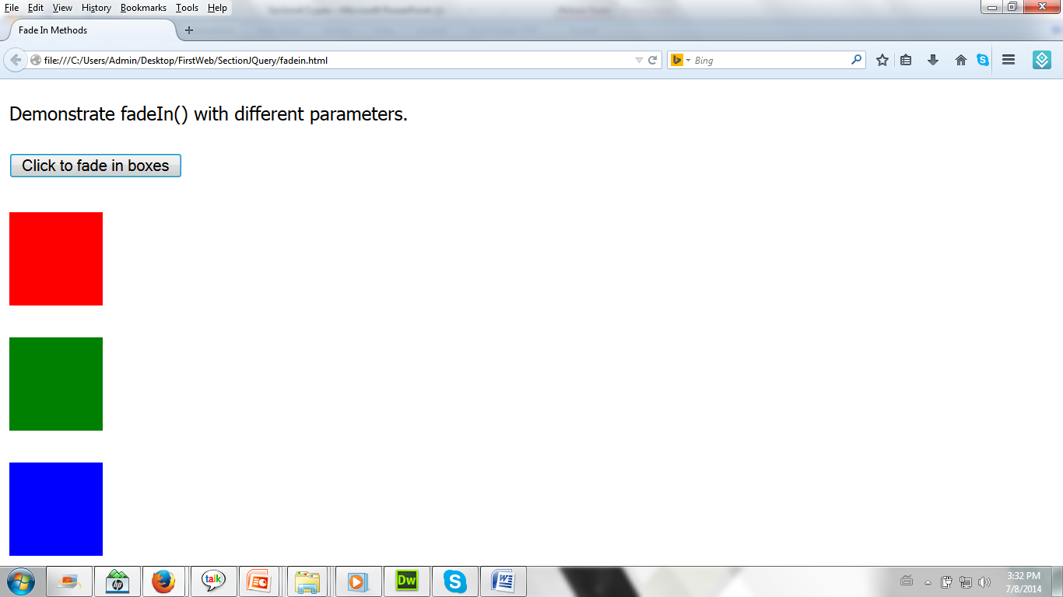
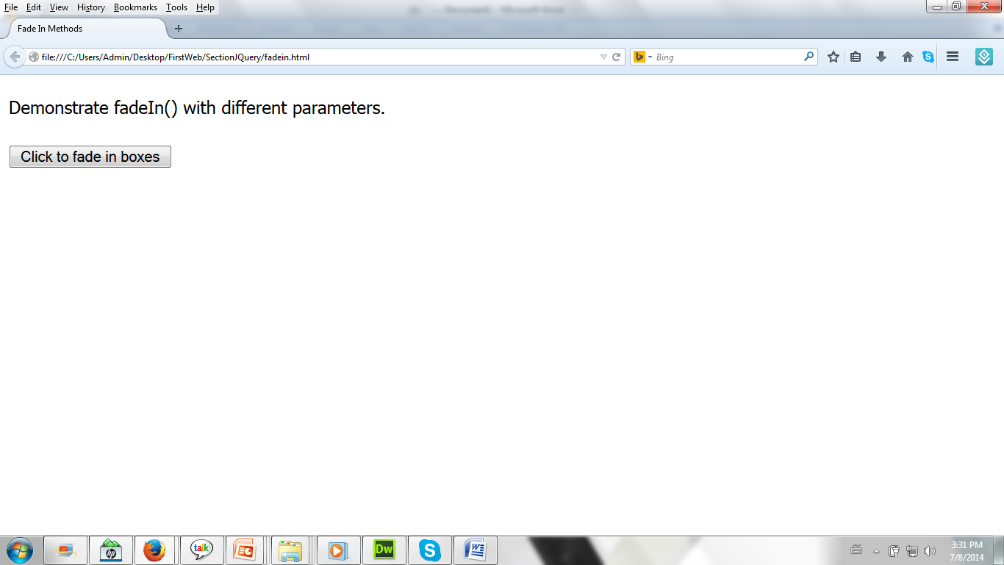
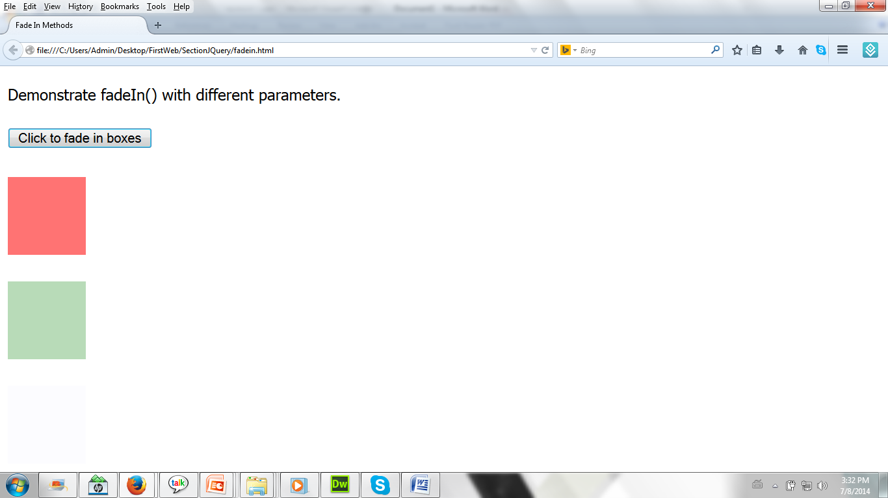
jQuery fadeIn() Example

Slide 46
jQuery fadeOut() Example
<script>
$(document).ready(function(){
$("button").click(function(){
$("#div1").fadeOut();
$("#div2").fadeOut("slow");
$("#div3").fadeOut(3000);
});
});
</script>

Slide 47
jQuery fadeOut() Example
<p>Demonstrate fadeOut() with different parameters.</p>
<button>Click to fade out boxes</button>
<br><br>
<div id="div1" style="width:80px;height:80px;background-color:red;"></div><br>
<div id="div2" style="width:80px;height:80px;background-color:green;"></div><br>
<div id="div3" style="width:80px;height:80px;background-color:blue;"></div>

Slide 48
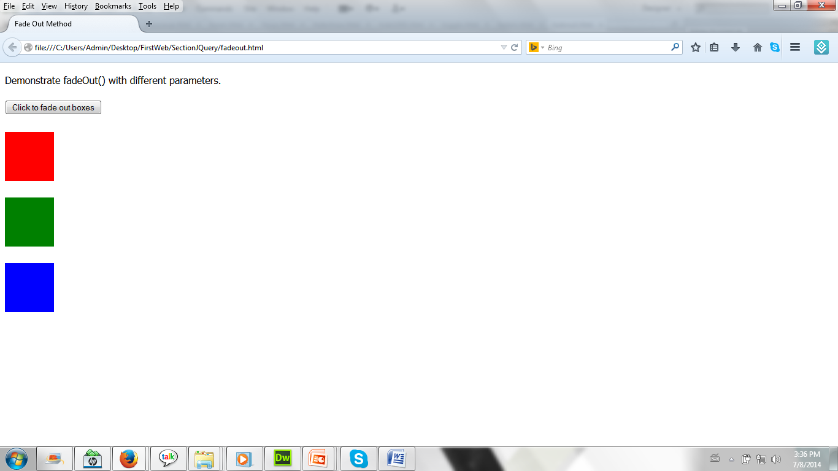
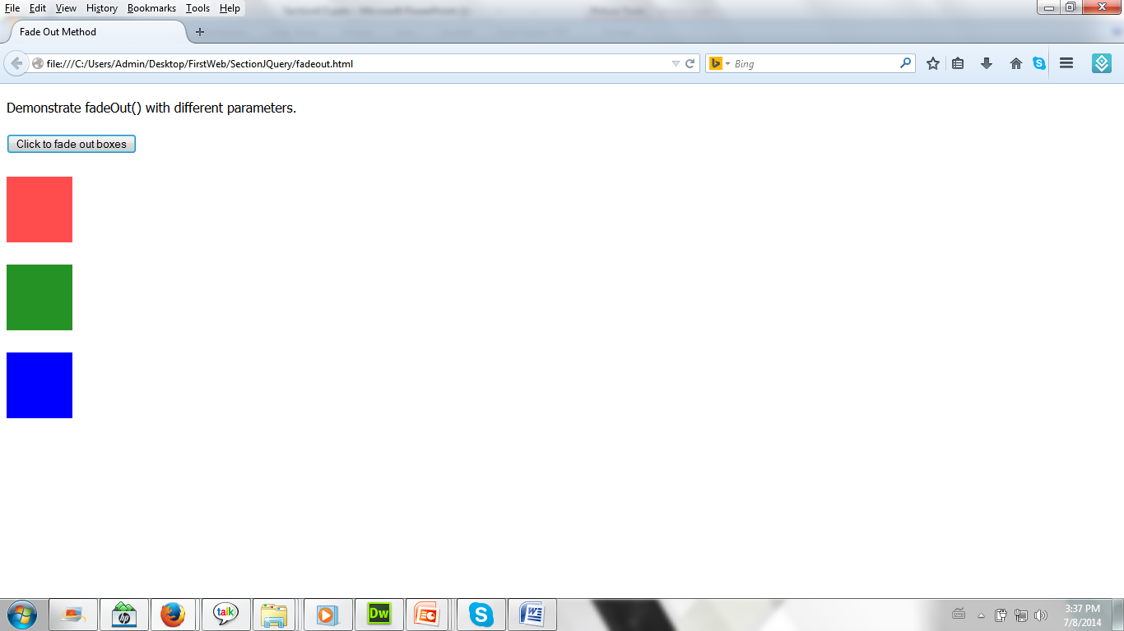
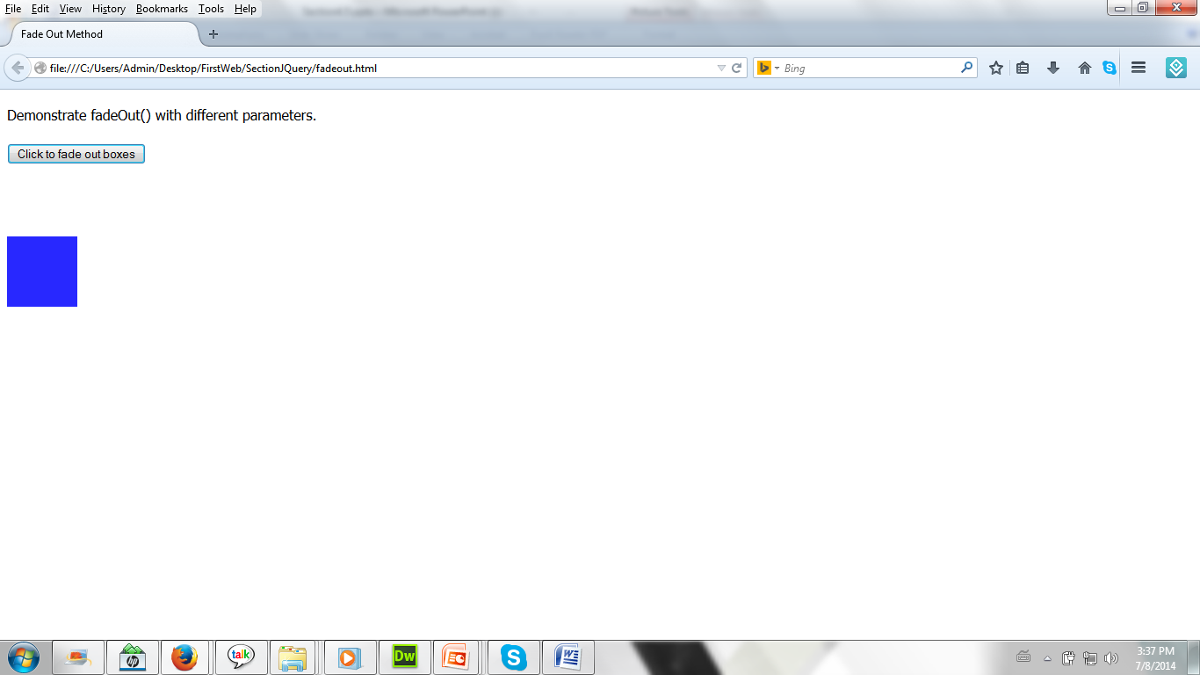
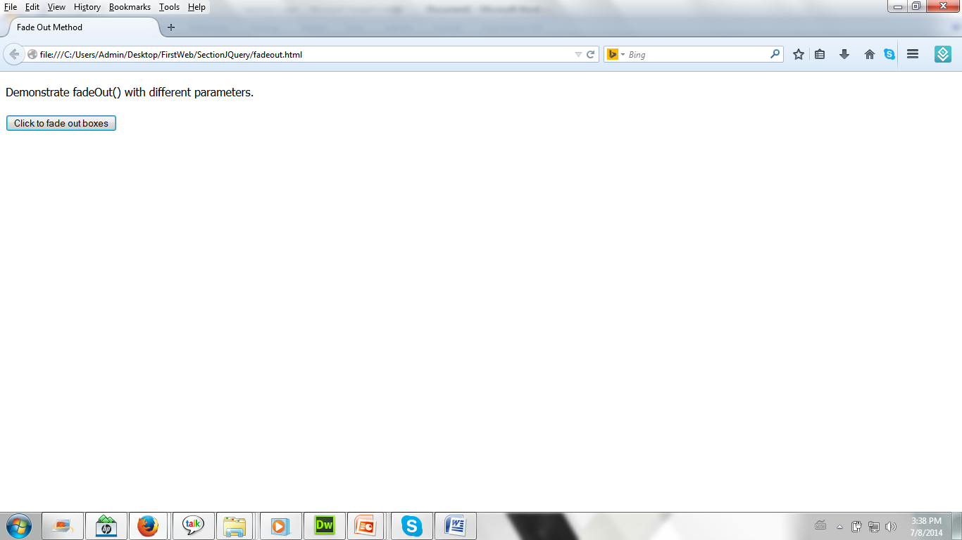
jQuery fadeOut() Example

Slide 49
jQuery fadeToggle() Example
<script>
$(document).ready(function(){
$("button").click(function(){
$("#div1").fadeToggle();
$("#div2").fadeToggle("slow");
$("#div3").fadeToggle(3000);
});
});
</script>

Slide 50
jQuery fadeTo() Example
<script>
$(document).ready(function(){
$("button").click(function(){
$("#div1").fadeTo("slow",0.15);
$("#div2").fadeTo("slow",0.4);
$("#div3").fadeTo("slow",0.7);
});
});
</script>

Slide 51
jQuery Effects:Sliding
With jQuery you can create a sliding effect on elements.
jQuery has the following slide methods:
-slideDown()
-slideUp()
-slideToggle()

Slide 52
jQuery Effects:Sliding
Syntax | Descriptions
$(selector).slideDown(); $(selector).slideDown(speed,callback); | The jQuery slideDown() method is used to slide down an element. The optional speed parameter specifies the duration of the effect. It can take the following values: "slow", "fast", or milliseconds. The optional callback parameter is a function to be executed after the sliding completes.
$(selector).slideUp(); $(selector).slideUp(speed,callback); | The jQuery slideUp() method is used to slide up an element. The optional speed parameter specifies the duration of the effect. It can take the following values: "slow", "fast", or milliseconds. The optional callback parameter is a function to be executed after the sliding completes.

Slide 53
jQuery Effects:Sliding
Syntax | Descriptions
$(selector).slideToggle(); $(selector).slideToggle(speed,callback); | The jQuery slideToggle() method toggles between the slideDown() and slideUp() methods. If the elements have been slid down, slideToggle() will slide them up. If the elements have been slid up, slideToggle() will slide them down. The optional speed parameter can take the following values: "slow", "fast", milliseconds. The optional callback parameter is a function to be executed after the sliding completes.

Slide 54
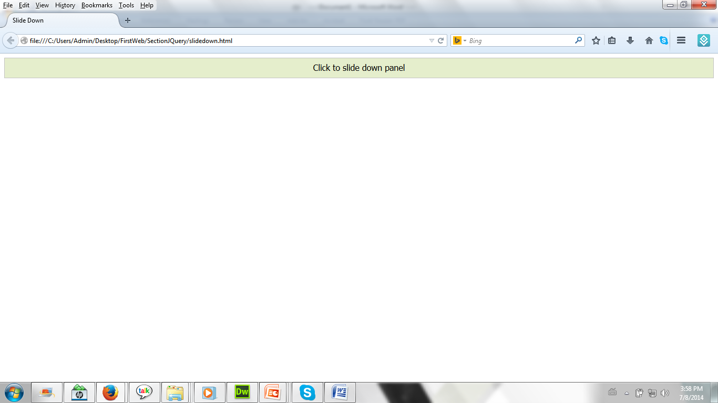
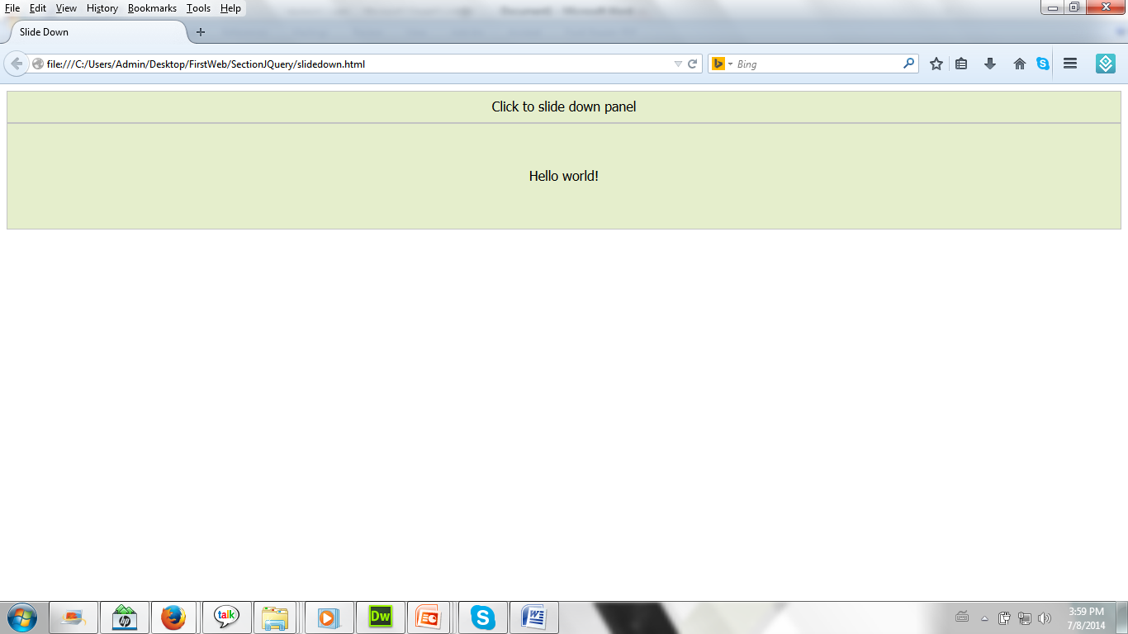
jQuery slideDown Example

Slide 55
jQuery slideDown Example
<script>
$(document).ready(function(){
$("#flip").click(function(){
$("#panel").slideDown("slow");
});
});
</script>

Slide 56
jQuery slideDown Example
<style>
#panel,#flip
{
padding:5px;
text-align:center;
background-color:#e5eecc;
border:solid 1px #c3c3c3;
}
#panel
{
padding:50px;
display:none;
}</style>

Slide 57
jQuery slideDown Example
<body>
<div id="flip">Click to slide down panel</div>
<div id="panel">Hello world!</div>
</body>

Slide 58
jQuery slideUpExample
<script>
$(document).ready(function(){
$("#flip").click(function(){
$("#panel").slideUp("slow");
});
});
</script>

Slide 59
jQuery slideToggle Example
<script>
$(document).ready(function(){
$("#flip").click(function(){
$("#panel").slideToggle("slow");
});
});
</script>

Slide 60
jQuery Effects:Animation
The jQuery animate() method lets you create custom animations.
Syntax | Description
$(selector).animate({params},speed,callback); | The required params parameter defines the CSS properties to be animated. The optional speed parameter specifies the duration of the effect. It can take the following values: "slow", "fast", or milliseconds. The optional callback parameter is a function to be executed after the animation completes.

Slide 61
jQuery Effects:Animation
<script>
$(document).ready(function(){
$("button").click(function(){
$("div").animate({
left:'250px',
opacity:'0.5',
height:'150px',
width:'150px'
});
});
});
</script>

Slide 62
jQuery Effects:Animation
<button>Start Animation</button>
<div style="background:#98bf21;height:100px;width:100px;position:absolute;">
</div>

Slide 63
Thank you!

